Slide 1
Web Scraping Fortune 500 Archive
Feb 2019

Slide 2
Goal
Be able to scrape Fortune 500 archive website
Clean the scrapped data and organize
Utilize the data for analysis
Big question:
Will following additions and deletions from Fortune 500 help with investing?

Slide 3
Scraping using Scrapy

Slide 4
What’s Involved
Simple to moderate complex site to scrape
57 Years of data
5 Page navigations per year
3 different HTML/css formats
500 links per year for details (Links scraped, but not crawled as the data is not needed for my analysis)

Slide 5
What I Tried with Scrapy
One output file per year – Helps with rerun only for required years
Use Input and Output processors
Abstract the 3 different XPATH formats to match the HTML/CSS

Slide 6
Analysis of Fortune 500 Data

Slide 7
About the Data
Sparse – most companies appear only for few years out of 58 years
Charts have spread out data with varying starting and end points – difficult to compare
Relative size of revenue/profits vary by large amounts, skewing the charts
Different names used for companies across years

Slide 8
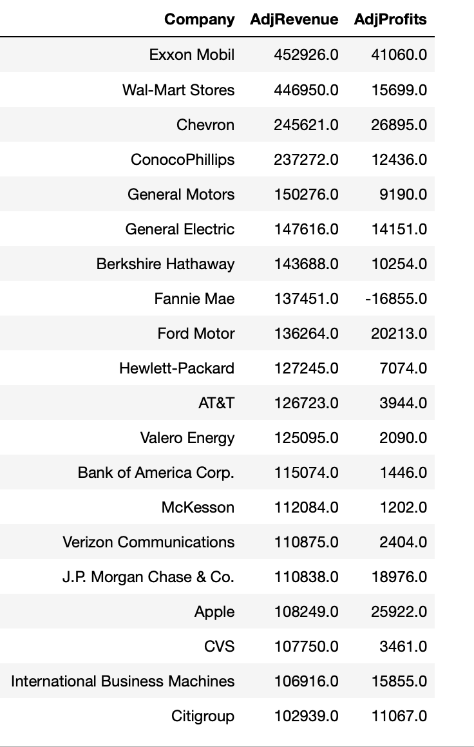
A quick look at what made the top 20 in 2012

Slide 9
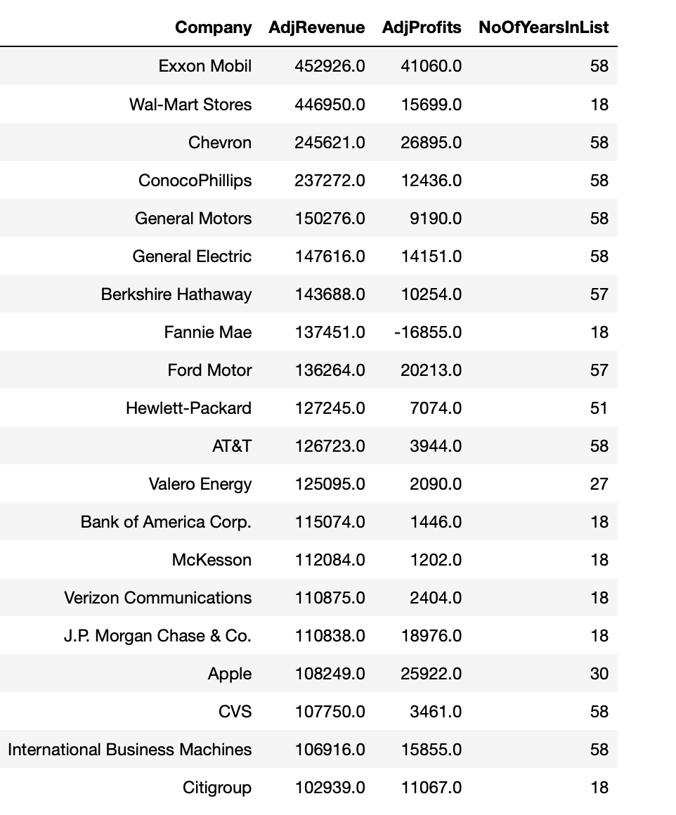
How about we look at how long they have been in the list..
Looks pretty stable

Slide 10
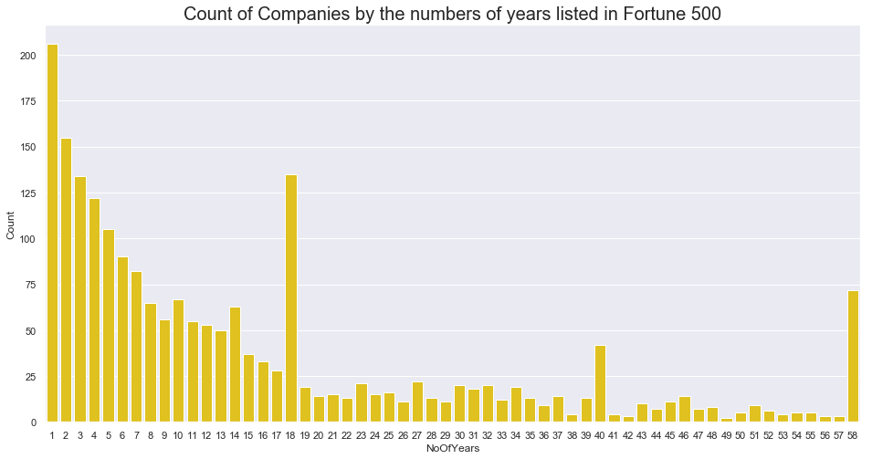
Not so fast!
Most companies get dropped with in few years after making it to the list

Slide 11
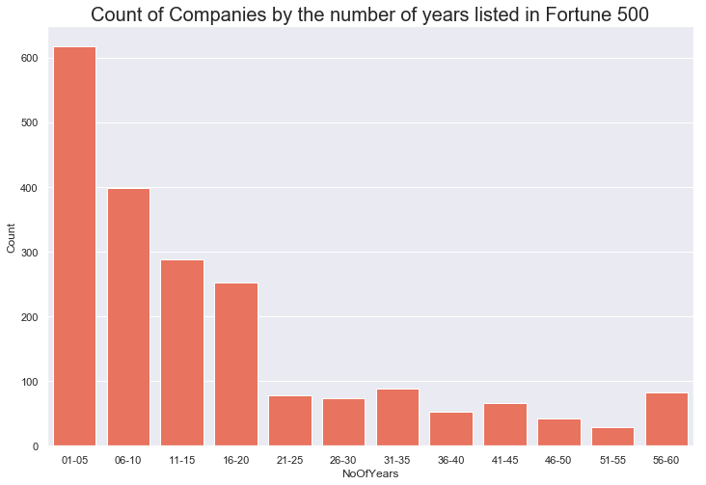
Another view, in 5 year bins

Slide 12
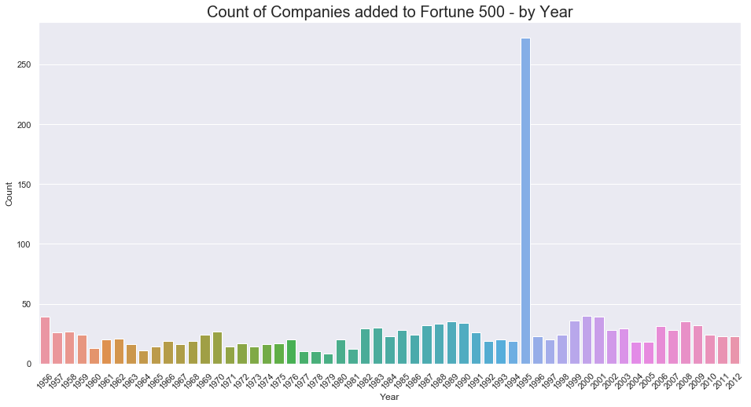
On Average there is 5% to 10% churn in the companies listed in Fortune 500
1995 seems like some kind of methodology change resulting in spike

Slide 13
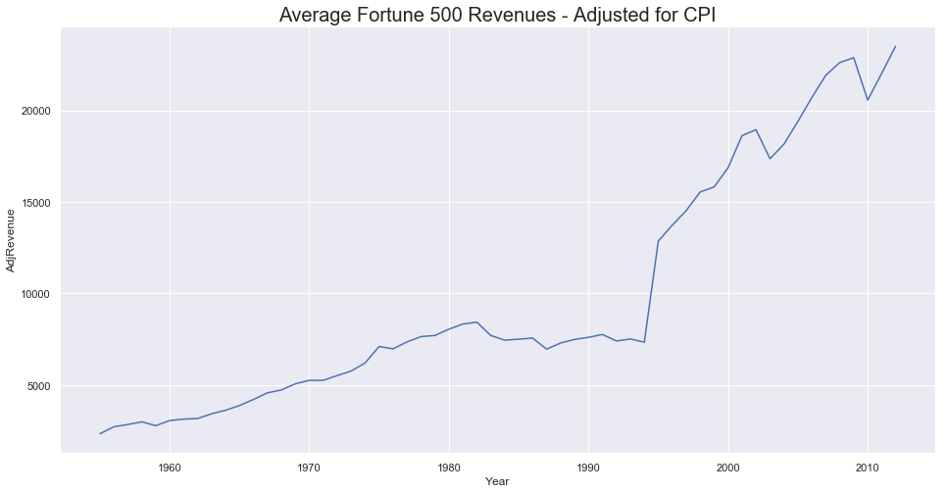
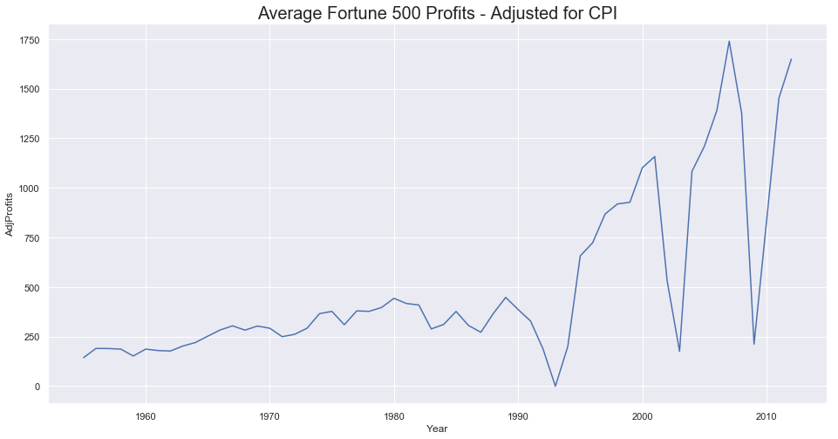
Let us start deep dive with average Revenue and Profits

Slide 14
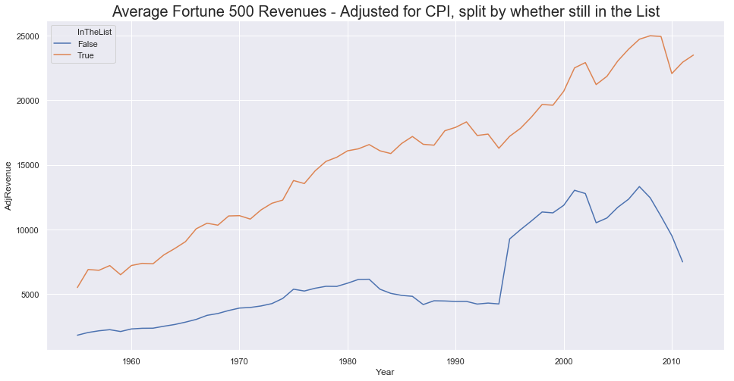
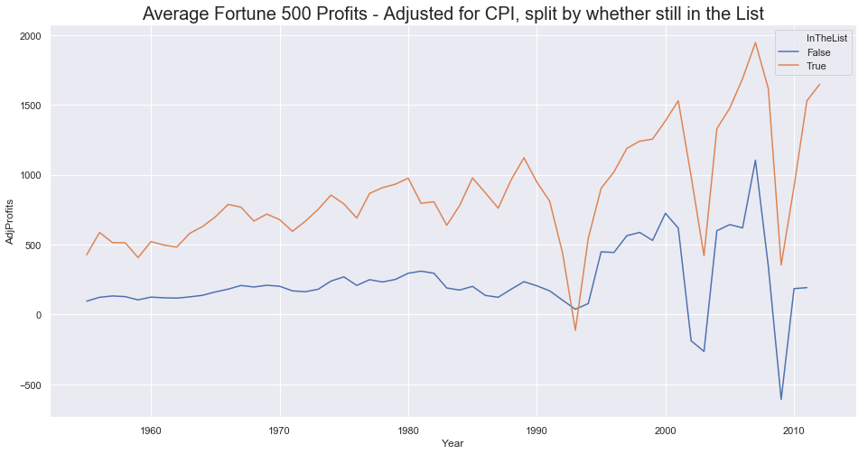
However, there is considerable gap between Companies that are still in the list and that are not

Slide 15
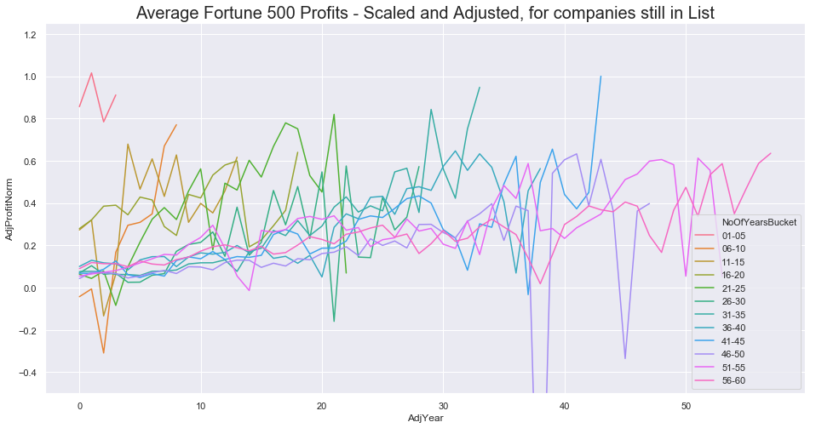
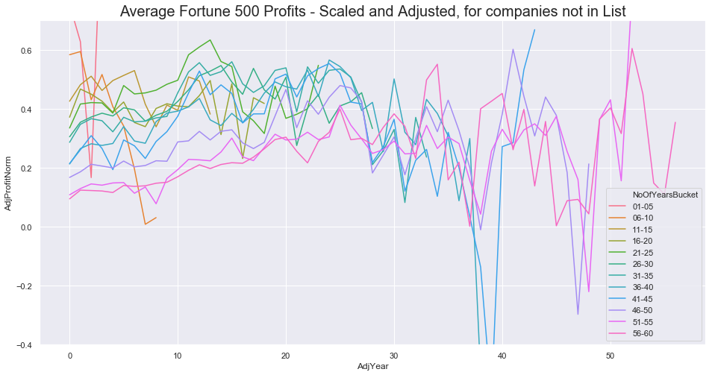
Profits by period bins – relatively trending up for companies still in the list

Slide 16
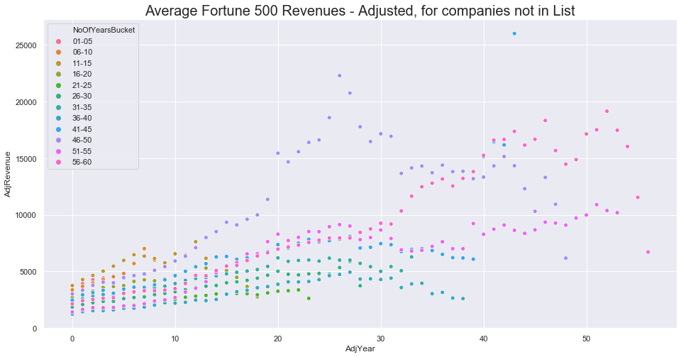
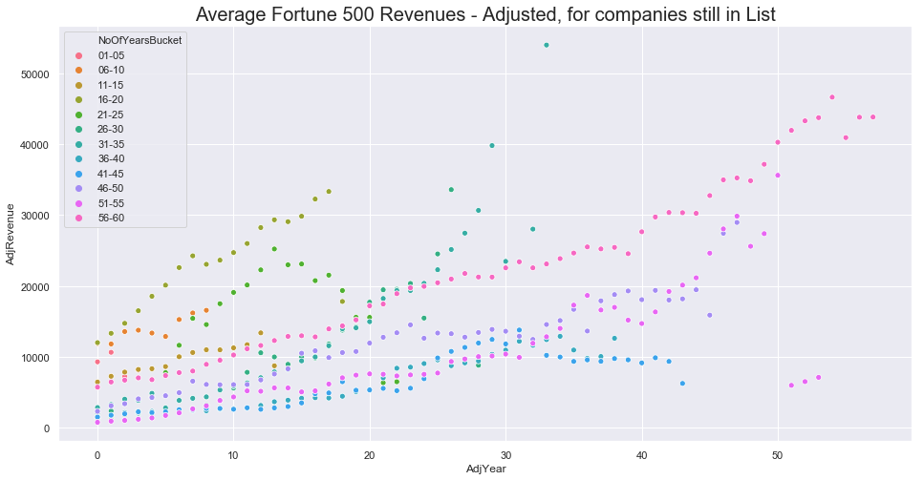
Revenue by period bins – relatively trending up for companies still in the list

Slide 17
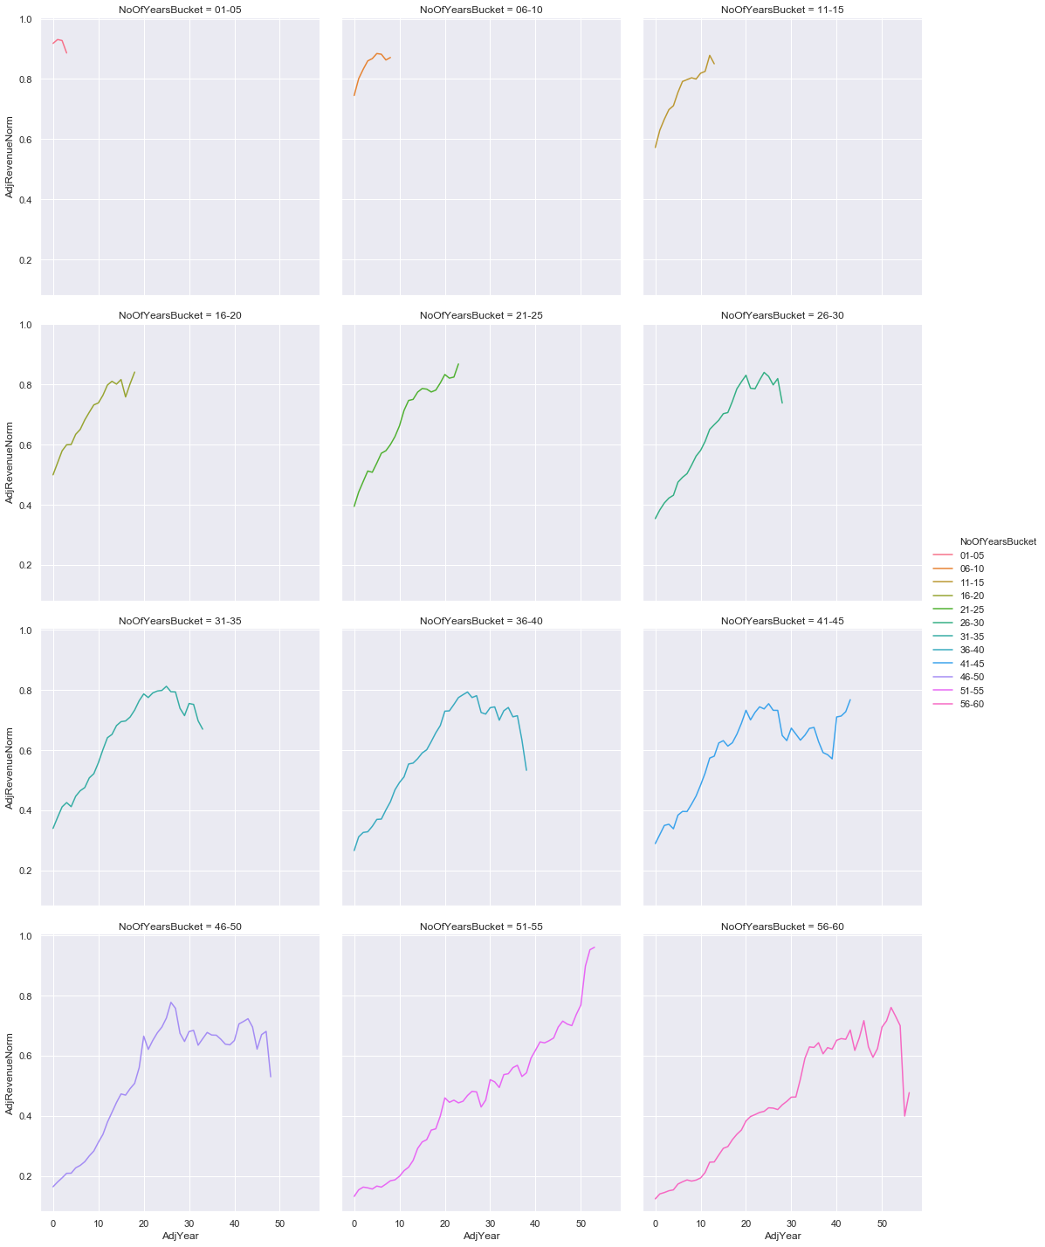
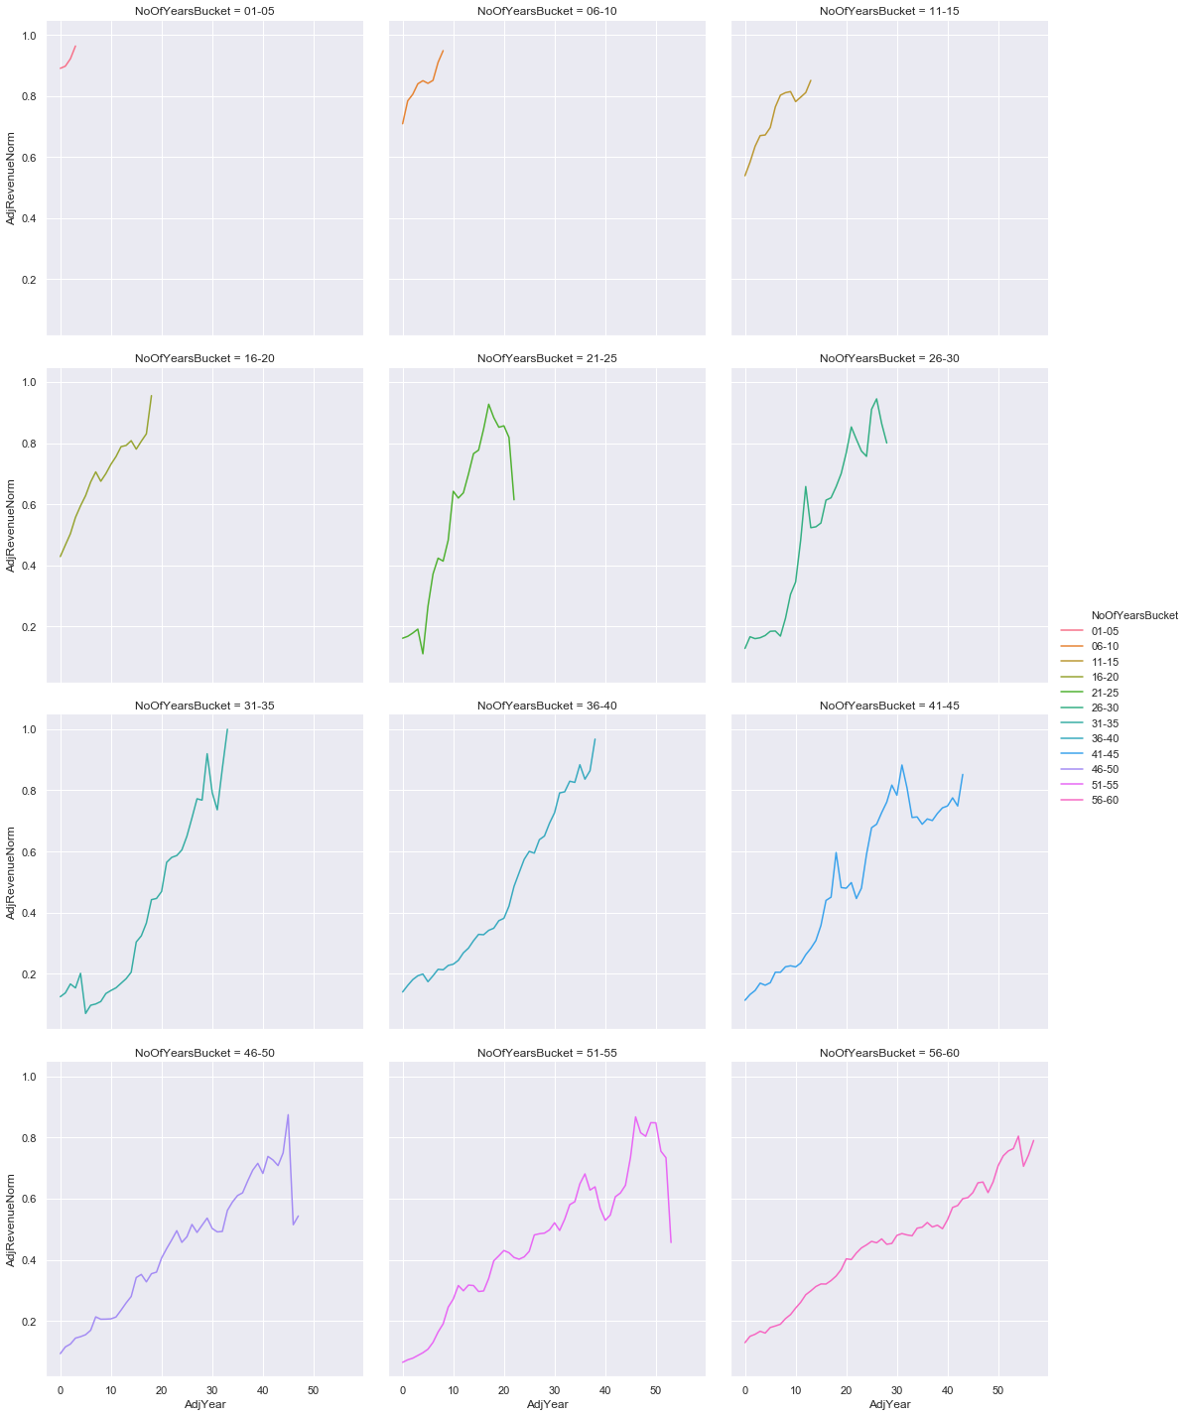
Revenue by period bins – relatively trending up for companies still in the list

